Slide 1
REPORT ON NEURAL STYLE TRANSFER

Slide 2
Introduction
Neural style transfer ( NST ) is the process of using Convolutional Neural networks to render a content image in different styles.
Gatys et al. was the first one to work on this topic and through his paper a new field NST have been generated .
Here we give an overview of all neural style transfer methods till 2018.

Slide 3
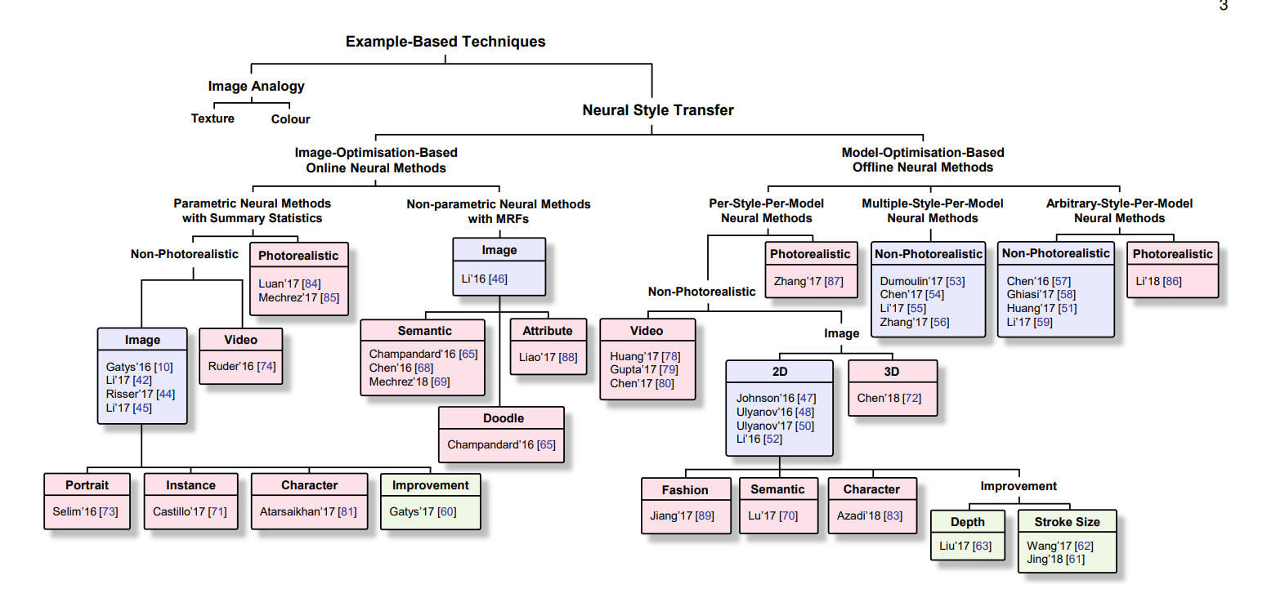
TAXANOMY OF NST TECHNIQUES

Slide 4
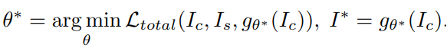
Different types of NST TECHNIQUES
Image Optimization Based Online neural methods (IOB – NST) :
In this algorithm we iteratively optimizes the input image until we get it similar to CNN representation . This process is time consuming especially when desired image is large.
Deep Dream is the first attempt to produce artistic images in this way . Most of the IOB – NST algorithms have the same IOB – IR ( Image Reconstructions ) techniques , they only differ in Visual style Modelling.
Model Optimization Based Offline Neural Methods :
In this method all the computation burden is put at the training stage. At testing stage reverse process can simply be done with a network forward pass .
MOB – NST address the speed and computational cost by exploiting MOB – IR to reconstruct the desired image .
A feed forward network g is optimized over large set of image I_c for one or more style images I_s is given by :

Slide 5
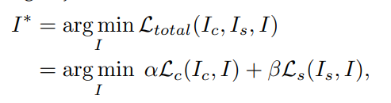
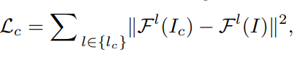
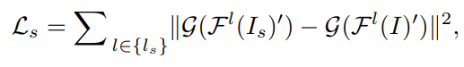
Different types of IOB – NST techniques
Parametric Neural Methods with Summary Statistics :
Here the style is characterized by a set of spatial summary statistics.
There are three developments in Non photorealistic of this method , they are : Gatys’16 , Li’17 , Risser’17
We had already seen Gatys’16 , which uses VGG – 19 model. Some formulas for the Gatys’16 are given below :

Slide 6
Different types of IOB – NST TECHNIQUES
Demerits of Gatys’16 :
Gayts’16 doesn’t perform well in preserving the coherence of fine structures and details during stylation since some of the low level information are lost by CNN features.
It also doesn’t apply for photorealistic synthesis due to limitation of gram based representation.
It also doesn’t contain the variations of brush strokes, semantics and depth information contained in the content image.
Gram based representations had instabilities in optimization , main reason for it is features with different mean , variance still have same gram matrix . Risser et al identified this and introduced extra histogram loss due to which he achieved more stable style transfer .
Li et al proved that matching gram based style representation between style and stylized images is nothing but minimizing the maximum mean discrepancy with a polynomial kernel. Lit el algo has good performance in preserving fine structures during stylation but still lacks considerations in semantics , depth , variations etc.

Slide 7
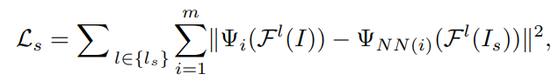
Different types of IOB – NST TECHNIQUES
Non parametric Neural Methods with MRFs :
These are built on the basis of Non paremtric texture modelling with MRFs.
Li and Wand are the first to propose a MRF based NST algorithm. They found that parametric based NST algo only captures per pixel features and doesn’t contain constrain the spatial layout leading to low accuracy results for photorealistic images.
They modeled style in a non parametric way and introduced new style loss function . Given by :
Where Ψ(F l (I)) denotes set of all patches from feature map F l (I). Ψi denotes ith local patch in the stylized image I. best matching ΨNN(i) is obtained by calculating normalized cross-correlation over all patches in style image Is. m is total number of patches . As algo matches style in patch level , arrangement is preserved.
Li & Wand model works good for photorealistic styles , especially when content , style image are similar in shape & perspective.

Slide 8
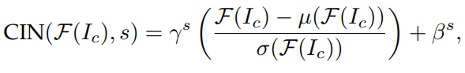
Types Of model optimization based offline neural methods
Depending upon the number of styles for a given feed forward network g , MOB NST are divided into 3 types.
Per Style Per Model Neural Methods :
Johnson et al & Ulyanov et al proposed a parametric pspm model , these 2 methods share similar idea. They only differ in network architecture.The objective functions in these 2 models are also same with Gatys et al.
These 2 models also have same limitations with that of the Gatys et al Model. Ulyanov used Instance Normalization i.e. batch size =1 which showed faster convergence than batch normalization.
Li & Wand proposed Non parametric PSPM with MRF model . Their method is shown to out perform Johnson model . However their model doesn’t give goof results for non texture styles .
Multiple Style Per Model Neural Methods :
Dumoulin had found that using same convolutional parameters but scaling & shifting them is sufficient to model for different styles. They introduced a formula

Slide 9
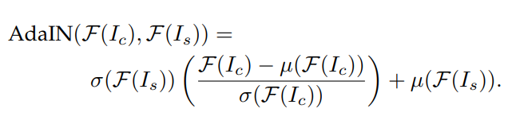
Types Of model optimization based offline neural methods
Another algo by Chen had also been proposed . He introduced a new layer called “Style Bank Layer “ . Each style has set of parameters to this layer & rest remains the same. For different styles we only train this layer , rest remains the same.
Arbitrary Style Per Model Neural Methods :
This model is nothing one model for all types of style images.The first model was introduced by Chen & Schmidt . They matched content patch with most similar style patch and swap them after than they constructed stylized image using IOB-IR or MOB –IR techniques. This technique results in less appealing images having content preservation with no style preservation.
Another method introduced by Huang & Belongie , they modified the CIN to AIN ( Adaptive Instance Normalization ) . Formula given by
This is first algo to achieve real time style transfer.

Slide 10
Improvements & extensions
For stroke size consistency , we can simply resize the image if it is non-high resolution image . For high resolution images stroke size won’t vary with the size of image . This problem is handled by coarse-to-fine IOB –NST procedure.
Limitation for NST is they don’t consider depth difference between content & style . This can be handled by adding depth loss to the loss function.
Semantic Style Transfer :
For a given pair of style & content images having similar content , we map each style region to semantically similar content region , those content region will be given this style .
Instance Style Transfer :
This is built on Instance segmentation , tries to stylize single user specified object with in the image.
There are many other different types of style transfer depending upon the method they are using for transferring such as Doodle style transfer , stereospecific style transfer , portrait style transfer , video style transfer , character style transfer , photorealistic style transfer , fashion style transfer , audio style transfer etc.

Slide 11
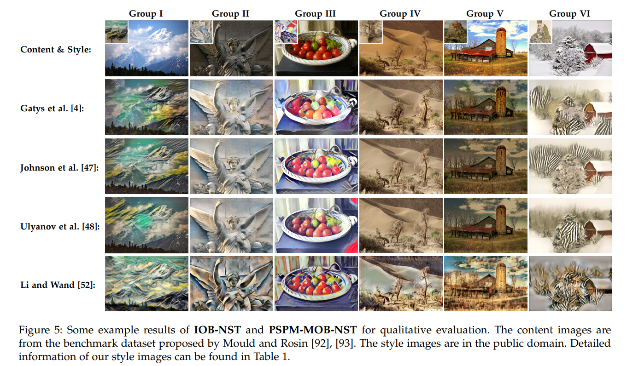
Evaluation
Here we can see results of IOB-NST , PSPM-MOB –NST .
IOB-NST results are quite appealing but it takes computationally more time. It is considered as gold-standard-method in NST.
Ulyanov & Johnson methods have almost same results . Results of Li & Wand are slightly less impressive because they use GAN for training.

Slide 12
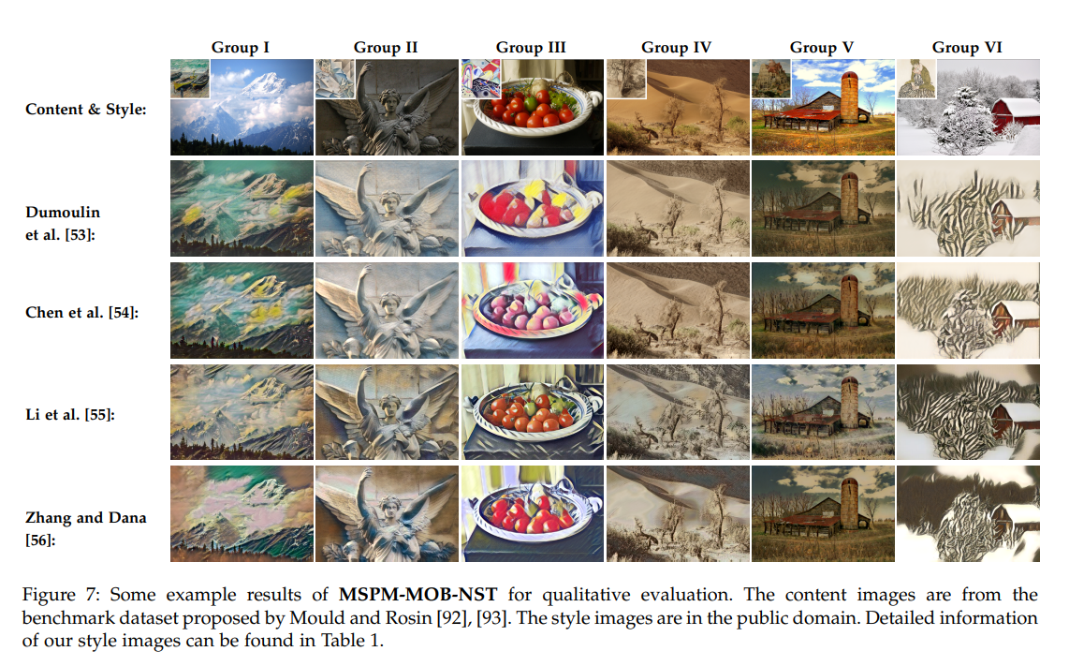
EVALUATION
Here we see results of MSPM-MOB-NST methods .
Dumoulin & Chen use the algorithm to tie a small number of parameters to each style.So their results are quite similar.But model size becomes large with increase in number of styles.
Li & Zhang use a single network with same trainable weights but the results are less appealing. But the model size issue is tackled.

Slide 13
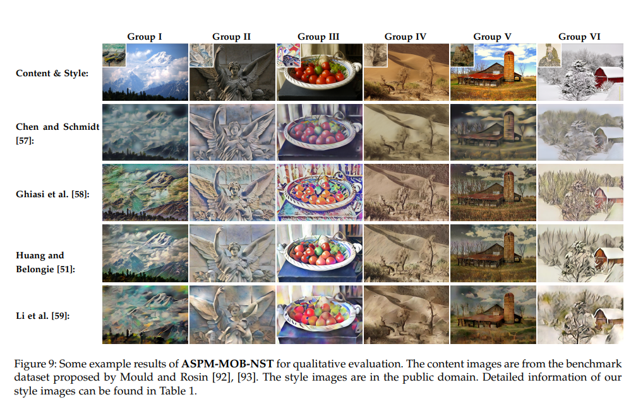
EVALUATION
Here we see results of ASPM-MOB-NST methods.
We can say that results are MSPM-MOB-IST are better than ASPM-IOB-NST but inferior to IOB-NST & PSPM-MOB-NST.

Slide 14
QUANTITATIVE EVALUATION
Basically we take 5 metrics to compare different models.
generating time for a single content image of different sizes
training time for a single model
average loss for content images to measure how well the loss function is minimized
loss variation during training to measure how fast the model converges;
style scalability to measure how large the learned style set can be.

Slide 15
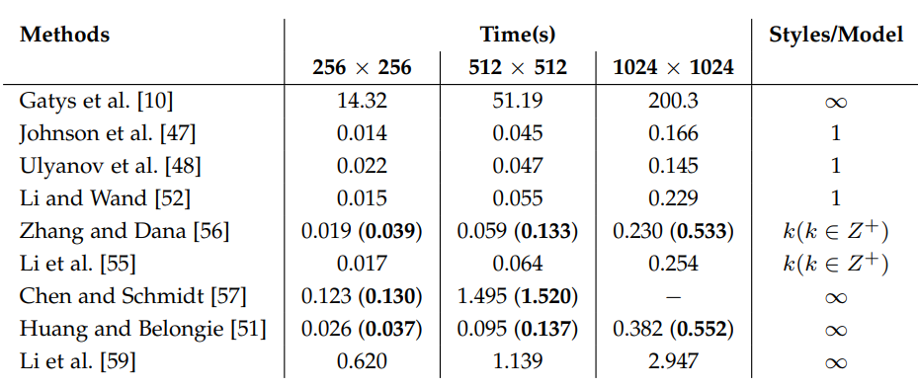
QUANTITATIVE EVALUATION
These results are obtained by averaging over 100 images for each method on a Pascal Titan X GPU .
We can see that all MOB-NST are capable of stylizing the image in real time.
ASPM is slower than PSPM & MSPM.

Slide 16
QUANTITATIVE EVALUATION
When we take NVIDIA Quadro M6000 , It takes 3.5 hours for Johnson , 3 hours for Ulyanov , 2 hours for Li & Wand , 4 hours for Zhang & Dhana , 8 hours for Li .
Training time can further reduced through incremental learning over pre trained model. Chen et al takes only 8 minutes to incrementally learn a style.

Slide 17
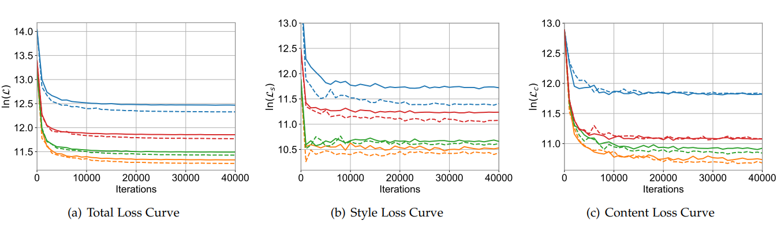
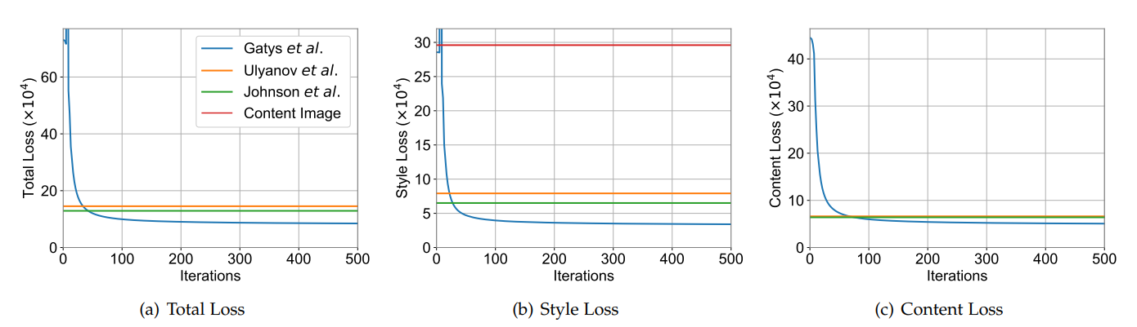
QUANTITATIVE EVALUATION
In figure 1 we compare losses between Ulyanov(solid ) & Johnson(dashed). We can see both converge at same rate but Johnson has good results.
In figure 2 we compare IOB-NST method Gayts with other MOB-NST methods , we can see MOB-NST computes in real time but it’s convergence of loss function is not as good as IOB-NST.

Slide 18
Applications
Due to the visually plausible stylized results, the research of NST has led to many successful industrial applications and begun to deliver commercial benefits.
Social Communication
User assisted creation tools
Production tools for Entertainment Applications

Slide 19
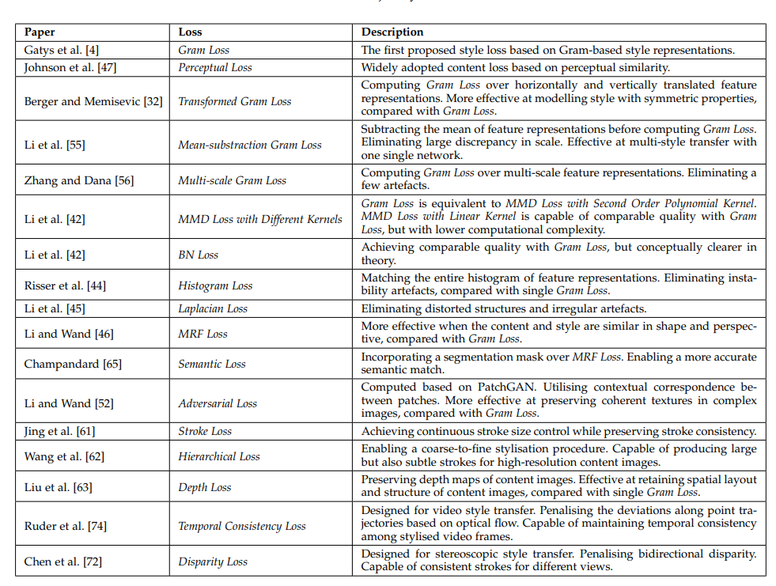

Slide 20
Conclusions
IOB-NST achieves superior performance in quality but is computationally expensive.
PSPM-MOB-NST achieves real-time stylization however PSPM-MOB-NST needs to train a separate network for each style, which is not flexible.
MSPM-MOB-NST improves the flexibility by incorporating multiple styles into one single model, but it still needs to pre-train a network for a set of target styles.
ASPM-MOB-NST algorithms successfully transfer arbitrary styles , But we are not satisfied with the results they are giving.

